Slide 1
The theme:
“It’s a secret”

Slide 2
May the road rise to meet you,
May the wind be always at your back,
May the sun shine warm upon your face,
May the rain fall short upon your fields,
And, until we meet again
May God hold you in the palm of his hand.

Slide 3
Сan you keep secrets?
Would you like to speak a secret language?
Where do you prefer to get information from?
Are you a reliable person?
When did you get your first mobile phone?
Do you surf the Internet?

Slide 4
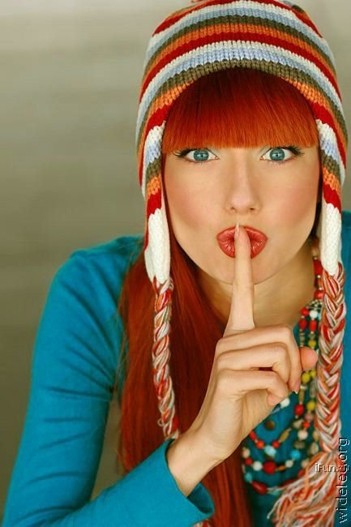
SECRET- it’s the information being kept in mystery.

Slide 5
complete the multiple choice task
Answer Key
1 B 3 D 5 C 7 D
2 D 4 C 6 B

Slide 6
FIND THE ANTONYMS
wartime,
fascinating,
create,
concealing,
essentially,
unbreakable,
complicated.

Slide 7
managed,
being contactable,
might be a little delayed,
inconvenient for everyone else,
to be disturbed

Slide 8
Answer Key
1A B2 3C 4B 5C 6B 7A

Slide 9
There’s a small chance that…
I’ve managed until now without…
Even my grandparents send me…
I can’t think of anything worse than…
But it would still be easier if…
Mobile phones are a part of…

Slide 10
Useful expressions
What do you think of…?
I quite like it/ them.
I can`t make my mind up.
I`m not very keen on it/ them.
I guess you`re right.

Slide 11
Thanks a lot for your work.
You really take the cake today.

